Slide 1
Campaign Funnel Classification
How I automatically labeled 637 ad campaigns — and what the labels revealed about website traffic
Part 1 — Classify each campaign as top-funnel or bottom-funnel
Part 2 — Show how funnel strategy fingerprints website traffic
1

Slide 2
BACKGROUND
The Problem
▪ An advertising company runs campaigns for many clients
– On Google, Meta (Facebook), TikTok, and LinkedIn
▪ Every campaign has a PURPOSE — but nobody labeled it
– Top-funnel = reach new people, build awareness ("say hello to strangers")
– Bottom-funnel = drive sales from warm audiences ("close the deal")
▪ Why does this matter?
– You cannot measure a "hello" ad and a "selling" ad the same way
– They need different budgets, different targets, different reports
▪ My task: automatically label every campaign — top or bottom
The core challenge
Zero labels to start with — a machine learning model needs examples to learn from, but nobody had labeled anything.
2

Slide 3
METHOD
My Approach: Two Simple Steps
No labels exist → a model can't learn. So I created labels first, then trained a model.
STEP 1 — Use Rules
No model needed. Look at 5 clues in the data:
"Who is the ad targeting?"
"What is the goal?"
"What does the ad look like?"
If the clues agree → assign a label.
STEP 2 — Train a Model
Use the Step 1 labels as "teaching examples."
The model learns the patterns
and labels ALL 637 campaigns —
including the ones the rules
couldn't figure out.
This two-step approach is called "weak supervision" — start with imperfect labels, then improve with a model.
3

Slide 4
STEP 1
Five Clues That Reveal the Campaign's Purpose
▪ Clue 1 — Who is the ad targeting?
– "Remarketing" (returning visitors) → bottom • "Broad audience" → top
▪ Clue 2 — What is the campaign's goal?
– "Awareness / Reach" → top • "Conversions / Sales" → bottom
▪ Clue 3 — What is the ad optimizing for?
– Impressions / Views → top • Purchases / Leads → bottom
▪ Clue 4 — What does the ad look like?
– Video (storytelling) → top • Lead form / product catalog → bottom
▪ Clue 5 — What is the campaign named?
– Keywords like "prospecting" / "launch" → top • "retarget" / "conversion" → bottom
Each clue votes independently. The label is set by majority vote.
Confidence = how many clues agreed (high / medium / low).
4

Slide 5
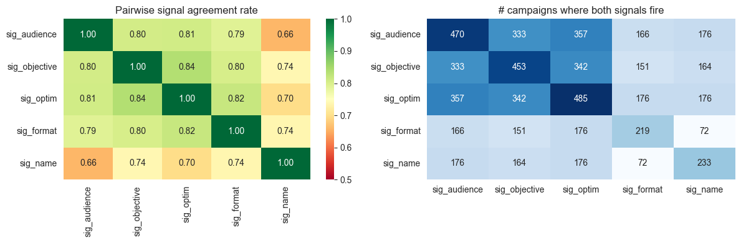
STEP 1
Results: Rules Labeled 92% of Campaigns
91.7%
▪ High confidence — 53% (3+ clues all agree)
▪ Medium confidence — 32% (clear majority)
▪ Low confidence — 7% (weak / conflicting signals)
▪ Unlabeled — 8% (no clue fired at all)
of campaigns labeled
by rules alone
Key decision: Only HIGH + MEDIUM labels train the model. Low-confidence & unlabeled → the model predicts these.
5

Slide 6
STEP 2
Training the Model
▪ 540 campaigns with confident labels → used as training data
▪ Two models compared
– A simple one (Logistic Regression) — fast, easy to explain
– A more complex one (LightGBM) — can catch more patterns
▪ Important safeguard: tested by holding out entire clients
– One client names all their ads in a similar style
– If some of their ads are in training and some in testing,
the model could recognize the style instead of learning the real pattern
– So I kept all of one client's ads on the same side → honest test score
▪ Labels I was more confident about counted more during training
6

Slide 7
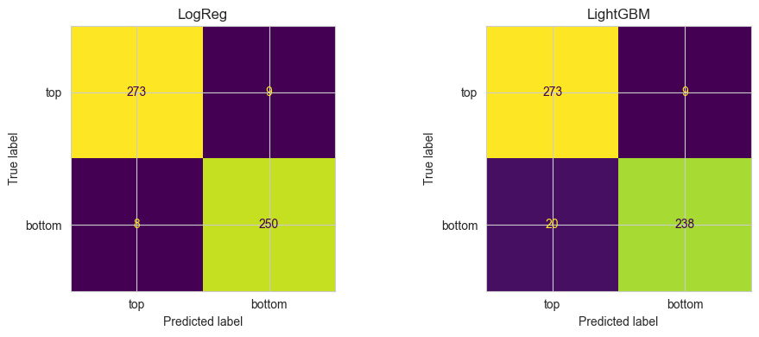
STEP 2
Results
0.994
97.6%
321 / 316
Model accuracy
(AUC score, out of 1.0)
Agreement with
Step 1 rules
Top / Bottom
final labels
▪ The simple model (Logistic Regression) won — AUC 0.994 vs 0.985 for the complex one
– When a simple approach works just as well, choose simple
▪ 97.6% agreement with the rules means the model learned the right patterns
– The 2.4% disagreement is mostly on low-confidence labels — the model may be correcting mistakes
7

Slide 8
REFLECTION
How Good Is This? — An Honest Look
▪ What went well
– Rules labeled 92% of campaigns with measurable confidence
– Model generalizes — tested by holding out whole clients (AUC 0.994)
– Model and rules agree on 97.6% — consistent, not random
▪ Honest limitation
– There is NO independent "answer key"
– The model is trained on rule-generated labels, and tested against the same kind
– If the rules have a blind spot, the model inherits it — and the test won't catch it
▪ What I would do next
– Manually check ~50 random campaigns myself → a small but truly independent test
– This is the single most important improvement
8

Slide 9
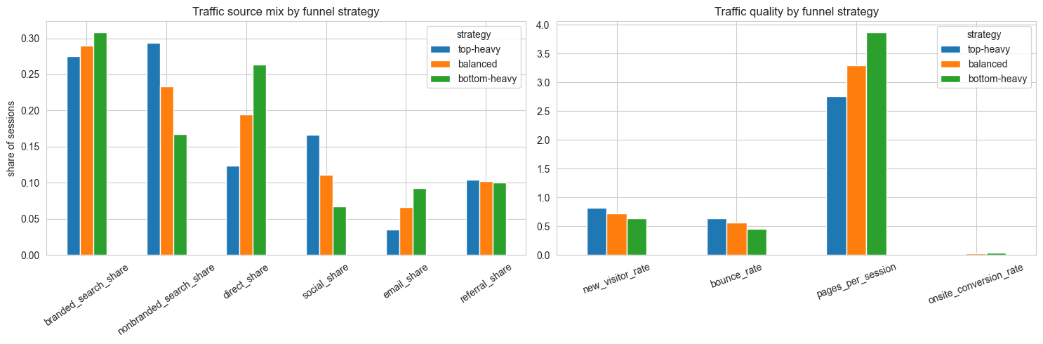
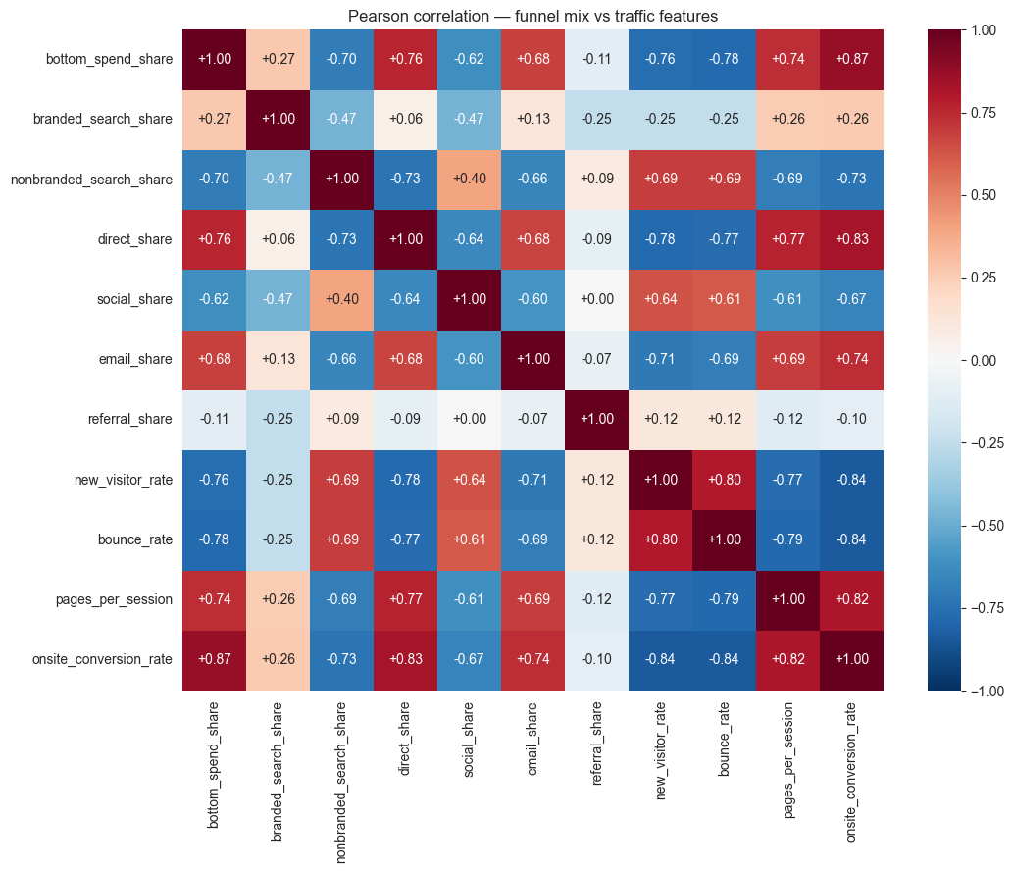
PART 2
Does Ad Strategy Leave a Fingerprint on Website Traffic?
▪ New dataset: each client's monthly website traffic — where visitors come from and how they behave
▪ Measured each client's "funnel mix" = share of budget spent on bottom-funnel ads
▪ Clients who spend more on bottom-funnel (selling ads):
– More direct visits & branded search • Higher conversion rate • Lower bounce rate
▪ Clients who spend more on top-funnel (awareness ads):
– More new visitors & social traffic • Higher bounce rate • More non-branded search
▪ The advertising strategy leaves a clear "fingerprint" on the website traffic
9

Slide 10
Conclusions & Next Steps
Delivered A two-stage pipeline labeled all 637 campaigns with a funnel level, a probability, and a confidence score.
Finding Funnel strategy leaves a clear fingerprint in website traffic — bottom-heavy clients convert better and rely on direct & branded traffic.
Limitation No independent ground truth. The model's labels come from the same rules used to create training data. Correlation ≠ causation in Part 2.
Next Step Hand-label ~50 campaigns as a truly independent test set. Re-run Part 2 using only high-confidence labels as a robustness check.
Thank you — questions welcome
10

